Slide 1

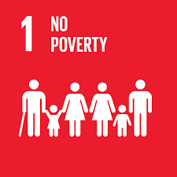

A Sexually Intercourse Deseases Education Awareness

Slide 2
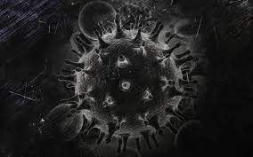

Problems
Lack of knowledge about HIV/AIDS information and Risk.
Increase population of Males patient.
Increase number of Sexual Contact mode of transmission.

Slide 3


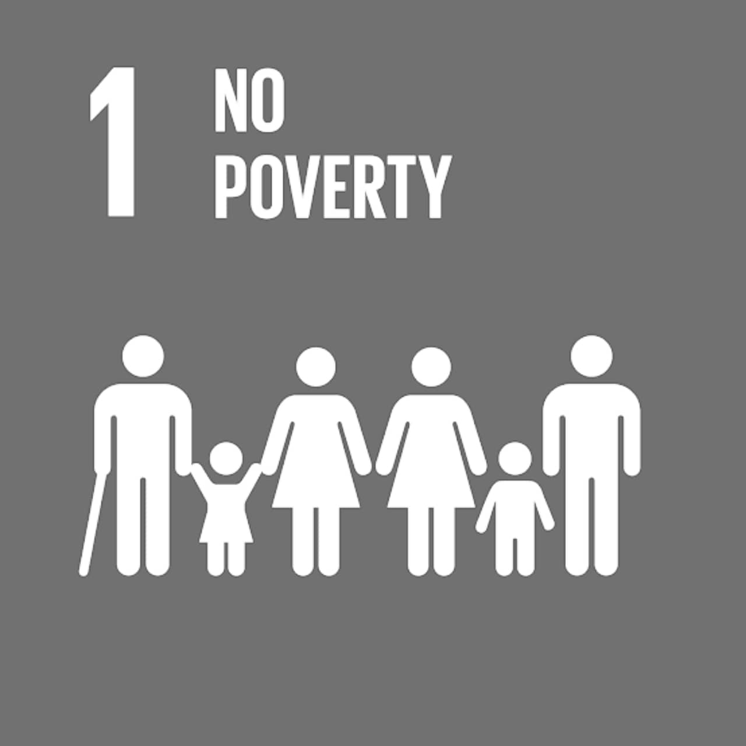
OBJECTIVES
To Raise General Awareness regards HIV/AIDS
To recognize the different stages of HIV
To review the situations the HIV/AIDS in philippines 2015-2021
To recommends on how to prevent or decrease the number population of HIV/AIDS

Slide 4

STAGES OF HIV INFECTION
1. Acute
Infection
2. Clinical
Latency
3. AIDS
Flu-like symptoms that occur within first 2-4 weeks of contracting HIV infection
Occurs when CD4 cell count falls below 2000 cells/mm3, and vulnurable to opportunistic infections
Chronic HIV infection after acute infection stage, can last for decades

Slide 5

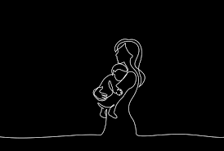
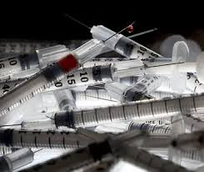
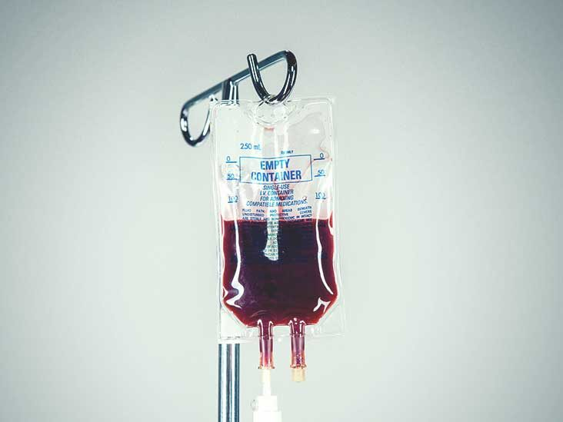
HOW HIV TRANSMITTED?
Sex without condom.
Sexual Contact
Pass from mother to baby.
Sharing injection equipment.
Contaminated blood transfusions & organ transplant.

Slide 6
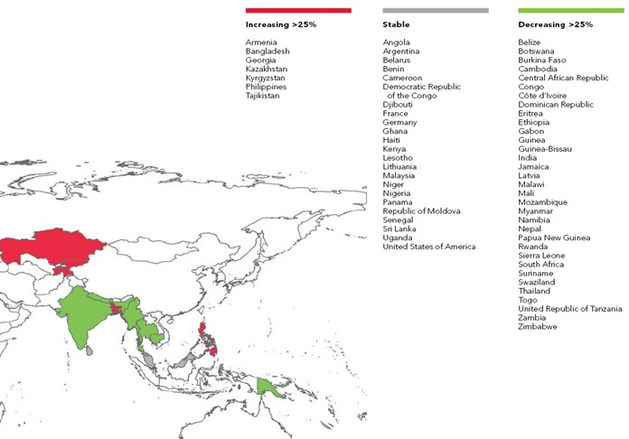
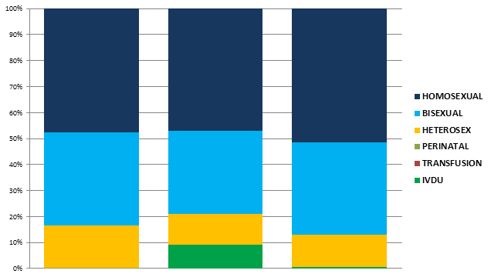
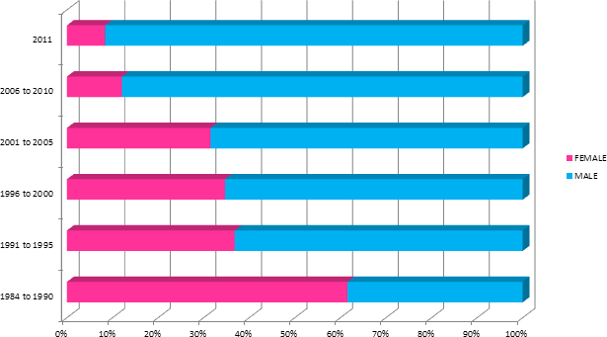
Year of 2009 63 countries reported.Philippines is one of the 7 countries with increasing HIV CASES.
..

Slide 7
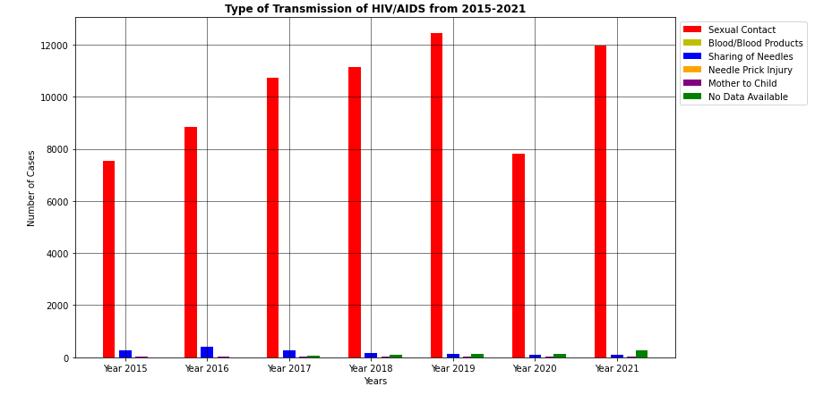
Mode of transmission 2015-2021

Slide 8
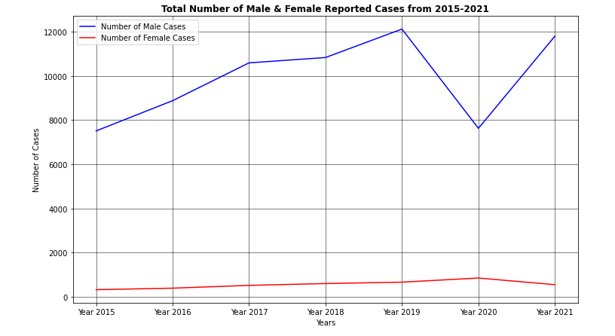
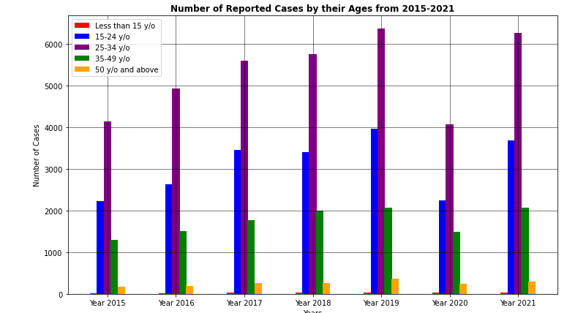
Reported cases by their ages 2015-2021
Total number of male and females reported cases from2015-2021

Slide 9

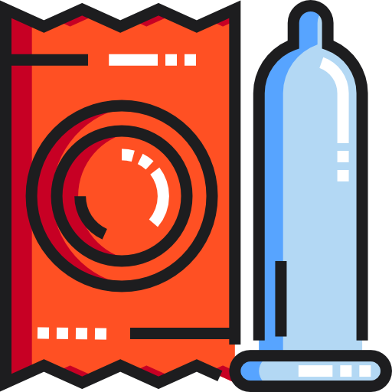


Recommendation:
Barangay Public awareness Campaign
Risk factors
USE CONDOMS
Anti-Discrimination

Slide 10

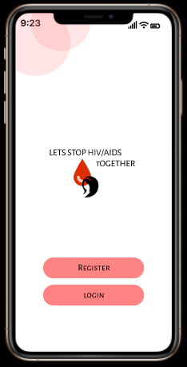

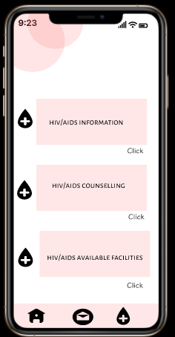
Innovation:
HIV/AIDS information system

Slide 11
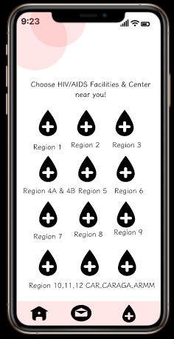
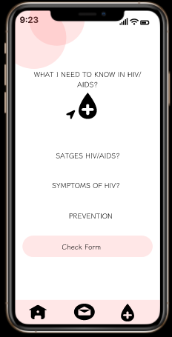
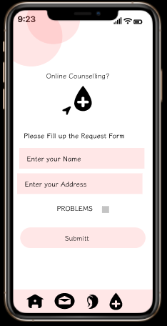
Innovation:
HIV/AIDS information system

Slide 12
Sustainable Development Goals

Slide 13
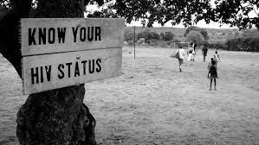
CTRL-CODE
Bentir, Cyra Mae
Dela Pena, Ma.Christine
Jemilehin,Bayode
Goot, Eryl Cresid
THANK YOU FOR LISTENING!
Mendoza, Jason Allen
QUESTIONS
Otutu,Johnpaul Ifeanyi
Quinal, Joshua

